Slide 1
THEORY OF COMPUTATION
Dr.S.Prince Mary M.E.,Ph.D., Associate Professor,
Department of Computer Science and Engineering,
School of Computing
SATHYABAMA
Institute of Science and Technology
Deemed to be University
Chennai.

Slide 2
UNIT- V RECURSIVE LANGUAGE AND UNDECIDABILITY

Slide 3
Syllabus
Recursively enumerable and recursive languages – Properties of Recursively enumerable and recursive languages - Enumerating a language. Introduction to
Undecidability- Halting Problem-Undecidability of Post correspondence problem (PCP)-Modified PCP -Rice Theorem.

Slide 4
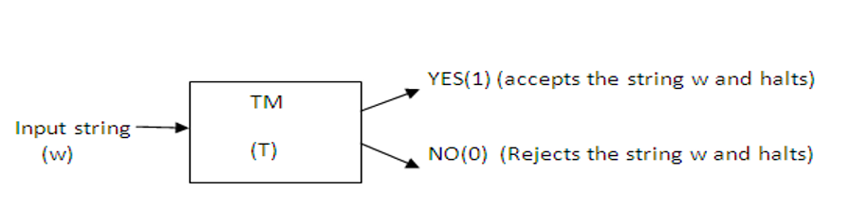
Recursive Language
A formal language is recursive if there exists a Turing machine (a Turing machine that halts for every given input)
When given a finite sequence of symbols as input, accepts it if it belongs to the language and rejects it otherwise.
Recursive Languages are also called Turing decidable languages.

Slide 5
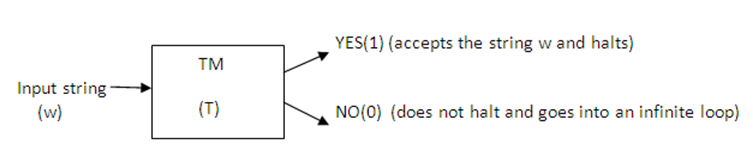
Recursively Enumerable Languages
A recursively enumerable language is a formal language for which there exists a Turing machine (or other computable function) .
Notes:
RE languages or type-0 languages are generated by type-0 grammars. An RE language can be accepted or recognized by Turing machine which means it will enter into final state for the strings of language and may or may not enter into rejecting state for the strings which are not part of the language. It means TM can loop forever for the strings which are not a part of the language. RE languages are also called as Turing recognizable languages.

Slide 6
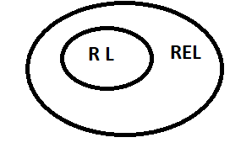
Relation between RL and REL

Slide 7
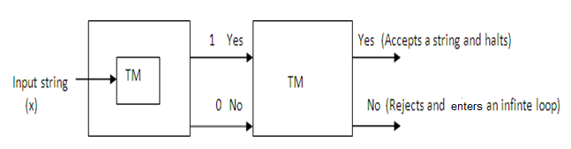
Theorem1:
Statement: Every recursive language is Recursively enumerable.
T( RL) U(REL)
If T is TM recognizing L(RL) then we can get a TM that accepts the language L by modifying T so that when the output is 0 it does not enter the reject state but enters into an infinite loop.

Slide 8
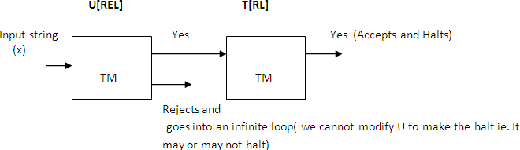
Theorem 2:
Statement: Every REL is not recursive.

Slide 9
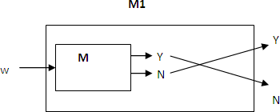
Theorem 3:
Statement: The complement of a RL is recursive (or) If L is recursive, so is L′.
Let L be a Recursive Language and M be the TM that halts on all inputs and accepts L.
Construct M1 for L′.
M accepts and halts for Yes, then M′ rejects and halts.
M rejects and halts for N, then M′ accepts and halts.

Slide 10
Theorem 4:
Statements:
Union of two recursive languages is recursive.
Union of two recursively enumerable languages is REL.
Intersection of two recursively enumerable languages is REL.

Slide 11
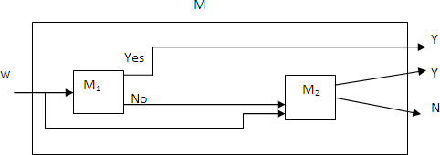
i. Union of two recursive languages is recursive.
Let L1 and L2 be the Recursive languages accepted by TMs M1 and M2.
Construct M:
It first simulates M1, If Yes than M accepts.
If M1 rejects, then M simulates M2 and accepts if and only if M2 accepts.
M accepts L1UL2.

Slide 12
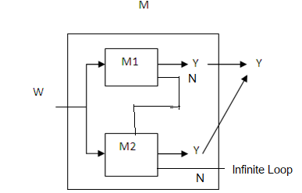
ii ) Union of two Recursively Enumerable Languages is REL.
Let L1 and L2 be the Recursive Enumerable languages accepted by TMs M1 and M2.
M simultaneously simulates M1 and M2.
If either accepts, then M accepts .i.e. M accepts L1UL2.

Slide 13
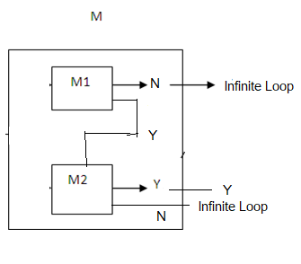
iii. Intersection of two recursively enumerable languages is REL.
Let L1 and L2 be the Recursive Enumerable languages accepted by TMs M1 and M2.
M halts if both M1 and M2 halts.
M will never halt if either M1 or M2 enter into infinite loop.
(i.e.)M accepts L1∩L2.

Slide 14
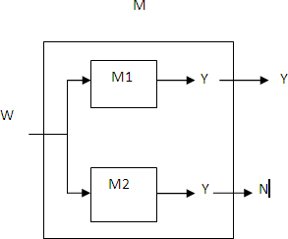
Theorem 5:
Statement: If a Language L and its complement L′ are both Recursively Enumerable, then L U L1 is recursive.

Slide 15
Theorem 5:
Statement: If a Language L and its complement L′ are both Recursively Enumerable, then L UL′ is recursive.
Let M1 and M2 be the TMs accepting L1 and L2 respectively.
M simultaneously simulates M1 and M2.
M1 accepts L and M2 accepts L′
If input to M is in L then M1 accepts and hence M accepts and halts. If input to M is not in L then M2 accepts and halts and hence M halts. Hence M halts on every input and so it is recursive.

Slide 16
Theorem Statements
Every recursive language is Reclusively enumerable.
Every REL is not recursive
The complement of a RL is recursive (or) If L is recursive, so is L’.
Union of two recursive languages is recursive.
Union of two recursively enumerable languages is REL.
Intersection of two recursively enumerable languages is REL.
If a Language L and its complement L’ are both Recursively Enumerable, then L and hence L’ are recursive.

Slide 17
Enumerating a Language:
To enumerate a set means to list out the elements one at a time.
A set is enumerable if there exists an algorithm for enumerating it.

Slide 18

A Turing Machine Enumerating a language:
Let T be a K tape Turing Machine (K≥1) and L⊊∑*.
T enumerates L if it operates so that the following conditions are satisfied.
The tape head on the first tape never moves to the left and no non blank symbol printed on tape 1 is subsequently modified or erased.
∀ XϵL, at some point in the operation of T, when tape1 has contents
Where X1,…….Xn,X are distinct elements of L.

Slide 19
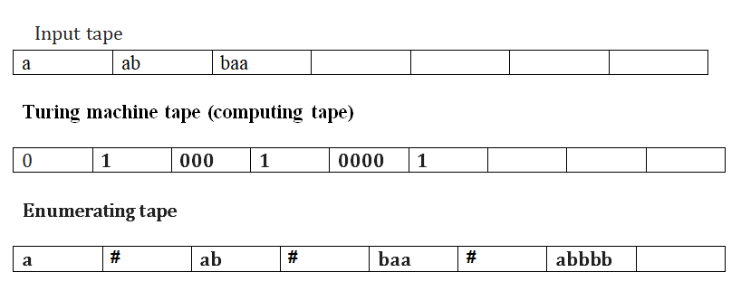
Theorem:
A language L⊊∑* is REL, if and only if L can be enumerated by some Turing Machine.
Proof:
If there is TM for enumerating language then there should be a Turing Machine for accepting same language.

Slide 20
Theorem:
A language L⊊∑* is REL, if and only if L can be enumerated by some Turing Machine.
Proof:
Let T be a TM enumerating L.
T1 accepting L is constructed as follows:
T1 has one more tape than T ie. Tape1 is the extra tape- input tape.
T1 simulates T, except that every time # is written on tape 1, simulation of T pauses while T1 compares the input string to the string just before #.
If the 2 strings match, T1 accepts.
T1 will accept precisely the strings that are generated on tape2, which are the elements of L.

Slide 21
To store the Enumerated Values:
If there is TM for enumerating language then there should be a Turing Machine for accepting same language.
Add one extra tape: T1-output tape
For all input it should compare with enumerating tape, if exist then write on the output tape.
Output tape: abbbb

Slide 22
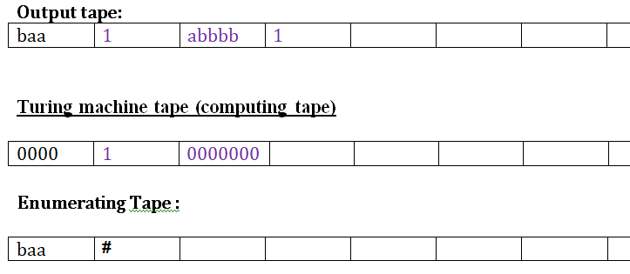
Converse:
Suppose T1 accepts L
Construct a 3-tape TM, T enumerating L
Tape 1- Output tape :
∑={a,b}* W={ꓥ,a,b,ab,aa,ab,ba,bb,aaa,………}

Slide 23
Undecidability
A decision problem is a problem that requires a yes or no answer.
A problem that cannot be decided by algorithmic means even after giving an unlimited resource and infinite amount of times, is termed as Undecidable.
A decision problem that admits no algorithmic solution is said to be undecidable.

Slide 24
Undecidability
For an undecidable language, there is no Turing Machine which accepts the language and makes a decision for every input string w (TM can make decision for some input string though).
Undecidable languages are not recursive languages, but sometimes, they may be recursively enumerable languages.

Slide 25

The Post ‘ S Correspondence Problem ( PcP)
An instance of Post’s correspondence problem (PCP) is a set {(α1, β1), (α2, β2), . . . , (αn, βn)} of pairs, where n ≥ 1 and the αi’s and βi’s are all nonnull strings over an alphabet .
The decision problem is this: Given an instance of this type, does there exist a positive integer k and a sequence of integers i1, i2, ...,ik with each ij satisfying 1 ≤ ij ≤ n, satisfying
αi1αi2 ...αik = βi1βi2 ...βik

Slide 26

Example 1: PCP
Consider the following domino’s
Solution :
BAABC
BAABC
Order: 1,2,4
B | A | ABC
BA | AB | C

Slide 27
Example 2: PCP
Consider the following domino’s
Solution :
111
11111111
Order: 1,
 | A | B
1. | 1 | 111
2. | 10111 | 10
3. | 10 | 0
1 | 1 | 1 | …..
111 | 111 | 111 | ……

Slide 28
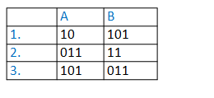
Example 3: PCP
Consider the following domino’s
Solution :
10101101101
101011011011
Order: 1,3
10 | 10 | 10 | …
101 | 101 | 101 | ….

Slide 29
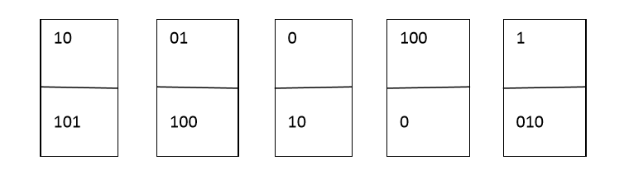


Example 4:
1 2 3 4 5
Solution:
1 5 2 3 4 4 3 4

Slide 30
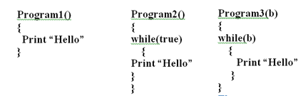
Halting Problem Halt Never halt May Halt or May not

Slide 31
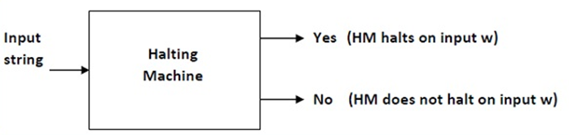
Halting Problem
Given a program/algorithm will ever halt or not?
Halting means that the program on certain input will accept it and halt or reject it and halt and it would never go into an infinite loop.
Basically halting means terminating.
So can we have an algorithm that will tell that the given program will halt or not.

Slide 32
In terms of Turing machine, will it terminate when run on some machine with some particular given input string.
The answer is NO. we cannot design a generalized algorithm which can appropriately say that given a program will ever halt or not?
Halting Problem is an undecidable problem because we cannot have an algorithm which will tell us whether a given program will halt or not in a generalized way i.e by having specific program/algorithm.

Slide 33
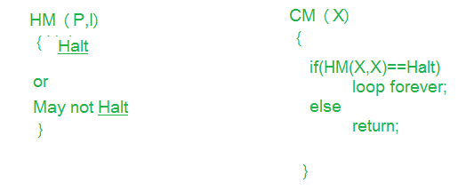
Theorem
Statement: Halting Problem is undecidable:
Proof by Contradiction :
Design a machine which if given a program can find out if that program will always halt or not halt on a particular input?
Solution:

Slide 34
Solution:
Let us assume that we can design that kind of machine called as HM(P, I) where HM is the machine/program, P is the program and I is the input.
On taking input the both arguments the machine HM will tell that the program P either halts or not.
If we can design such a program this allows us to write another program we call this program CM(X) where X is any program(taken as argument) and according to the definition of the program CM(X) shown in the figure.

Slide 35
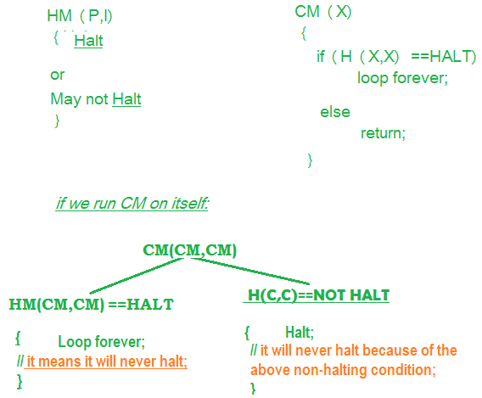

Slide 36
In the program CM(X) we call the function HM(X), which we have already defined and to HM() we pass the arguments (X, X), according to the definition of HM() it can take two arguments i.e one is program and another is the input.
Now in the second program we pass X as a program and X as input to the function HM().
We know that the program HM() gives two output either “Halt” or “Not Halt”.
But in case second program, when HM(X, X) will halt loop body tells to go in loop and when it doesn’t halt that means loop, it is asked to return.

Slide 37
It is impossible for outer function to halt if its code (inner body) is in loop and also it is impossible for outer non halting function to halt even after its inner code is halting.
So the both condition is non halting for CM machine/program even we had assumed in the beginning that it would halt.
So this is the contradiction and we can say that our assumption was wrong and this problem, i.e., halting problem is undecidable.

Slide 38
RICE THEOREM
Any non-trivial property of the LANGUAGE recognizable by a Turing machine is undecidable
OR
For every nontrivial property P of the RE languages, L_{P} is undecidable.
To Prove Rice Theorem, the following to be clarified:
Property of a Language
Problem of Reduction

Slide 39
Properties of Languages
Any set of languages is a property of languages.
Example: The infiniteness property is the set of infinite languages.
As always, languages must be defined by some descriptive device.
The most general device we know is the TM.
Thus, a property as a problem about Turing machines.
Let L_{P} be the set of binary TM codes for TM’s M such that L(M) has property P.

Slide 40
Trivial and Non-Trivial Properties
Property of languages, P, is simply a set of languages.
If any language belongs to P (L ∈ P), it is said that L satisfies the property P.
A property is called to be trivial if either it is not satisfied by any recursively enumerable languages, or if it is satisfied by all recursively enumerable languages.

Slide 41
A non-Trivial Property
A non-trivial property is satisfied by some recursively enumerable languages and are not satisfied by others.
Formally speaking, in a non-trivial property, where L ∈ P, both the following properties hold:
Property 1 − There exists Turing Machines, M1 and M2 that recognize the same language, i.e. either ( <M1>, <M2> ∈ L ) or ( <M1>,<M2> ∉ L )
Property 2 − There exists Turing Machines M1 and M2, where M1 recognizes the language while M2 does not, i.e. <M1> ∈ L and <M2> ∉ L

Slide 42
Reductions
A reduction from language L to language L’ is an algorithm (TM that always halts) that takes a string w and converts it to a string x, with the property that:
x is in L’ if and only if w is in L.
If we reduce L to L’, and L’ is decidable,
then the algorithm for L’ + the algorithm of the reduction shows that L is also decidable.

Slide 43
Picture of the Reduction
Accept
iff M
accepts w
A real
reduction
algorithm
Hypothetical
algorithm for
property P
M, w
M’
Otherwise
halt without
accepting
This would be an algorithm
for L_{u}, which doesn’t exist

Slide 44
Proof of Rice’s Theorem
Assume: every nontrivial property P of the RE languages, L_{P} is decidable.
We show how to reduce L_{u} to L_{P}.
Since we know L_{u} is decidable, it follows that L_{P} is also decidable.

Slide 45
The Reduction
Our reduction algorithm must take M and w and produce a TM M’.
L(M’) has property P if and only if M accepts w.
M’ has two tapes, used for:
Simulates another TM- M_{L} on the input to M’.
Simulates M on w.
Note: neither M, M_{L}, nor w is input to M’.

Slide 46
The Reduction – (2)
Assume that ∅ does not have property P.
Proof
Let L be any language with property P, and let M_{L} be a TM that accepts L.

Slide 47
Design of M’
On the second tape, write w and then simulate M on w.
If M accepts w, then simulate M_{L} on the input x to M’, which appears initially on the first tape.
M’ accepts its input x if and only if M_{L} accepts x.

Slide 48
Action of M’ if M Accepts w
On accept
Simulate M
on input w
Simulate M_{L}
on input x
x
Accept
iff x is
in M_{L}

Slide 49
Design of M’ – (2)
Suppose M accepts w.
Then M’ simulates M_{L} and therefore accepts x if and only if x is in L.
That is, L(M’) = L, L(M’) has property P, and M’ is in L_{P}.

Slide 50
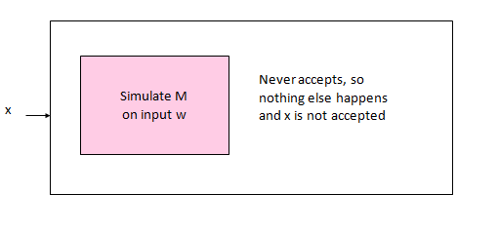
Design of M’ – (3)
Suppose M does not accept w.
Then M’ never starts the simulation of M_{L}, and never accepts its input x.
Thus, L(M’) = ∅, and L(M’) does not have property P.
That is, M’ is not in L_{P}.

Slide 51
Design of M’ – Conclusion
Thus, the algorithm that converts M and w to M’ is a reduction of L_{u} to L_{P}.
Thus, L_{P} is undecidable.
Hence Rice Theorem is proved

Slide 52
Applications of Rice’s Theorem
We now have any number of undecidable questions about TM’s:
Is L(M) a regular language?
Is L(M) a CFL?
Does L(M) include any palindromes?
Is L(M) empty?
Does L(M) contain more than 1000 strings?
Etc., etc.

Slide 53
THANK YOU

